Slide 1
Developing an ERD
Dr. Hemn Barzan Abdalla

Slide 2
The process of database design is an iterative rather than a linear or sequential process.
Building an ERD usually involves the following activities:
Create a detailed narrative of the organization’s description of operations.
Identify the business rules based on the description of operations.
Identify the main entities and relationships from the business rules.
Develop the initial ERD.
Identify the attributes and primary keys that adequately describe the entities.
Revise and review the ERD.

Slide 3
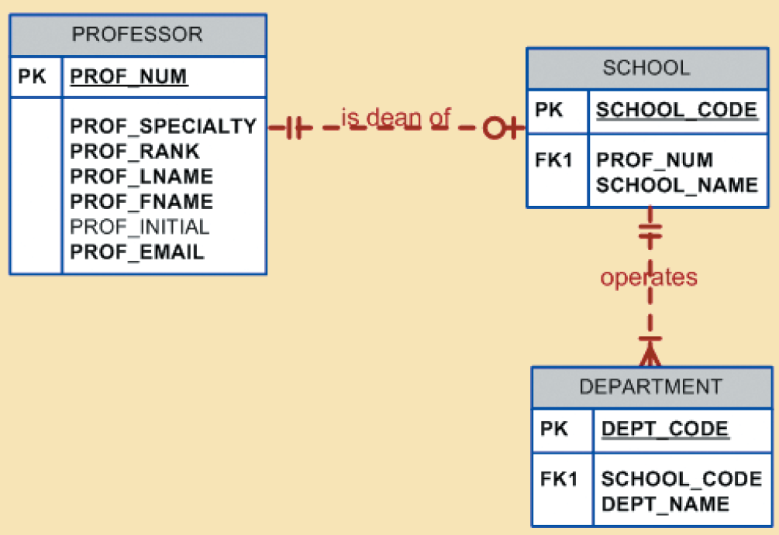
Example of a database in Tiny College
1. Tiny College is divided into several schools: a school of business, a school of arts and sciences, a school of education, and a school of applied sciences. Each school is administered by a dean who is a professor. Each professor can be the dean of only one school, and a professor is not required to be the dean of any school.
2. Each school comprises several departments. For example, the school of business has an accounting department, a management/marketing department, an economics/finance department, and a computer information systems department.

Slide 4
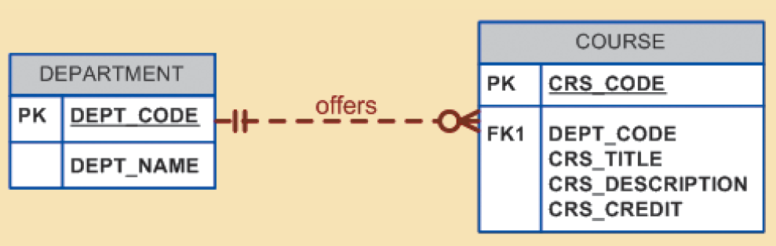
Example of a database in Tiny College
3. Each department may offer courses. For example, the management/marketing department offers courses such as Introduction to Management, Principles of Marketing, and Production Management.
Note that this relationship is based on the way Tiny College operates.
If, for example, Tiny College had some departments that were classified as “research only,” those departments would not offer courses; therefore, the COURSE entity would be optional to the DEPARTMENT entity.

Slide 5
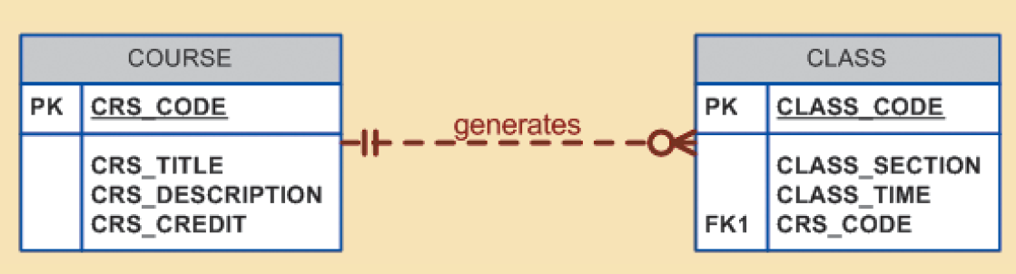
Example of a database in Tiny College
4. A CLASS is a section of a COURSE. That is, a department may offer several sections (classes) of the same database course. Each of those classes is taught by a professor at a given time in a given place.
In short, a 1:M relationship exists between COURSE and CLASS. However, because a course may exist in Tiny College’s course catalog even when it is not offered as a class in a current class schedule, CLASS is optional to COURSE.

Slide 6
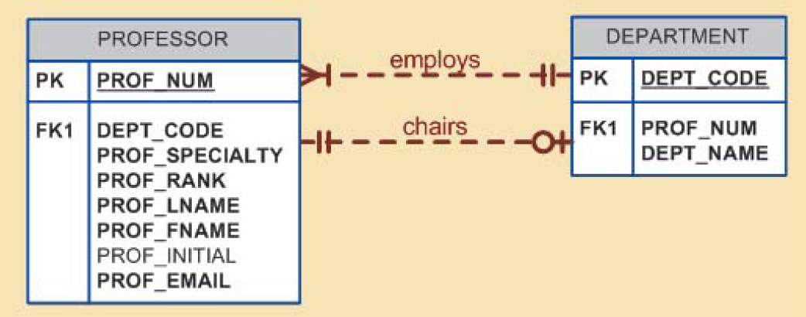
Example of a database in Tiny College
5. Each department should have one or more professors assigned to it. One and only one of those professors chairs the department, and no professor is required to accept the chair position. Therefore, DEPARTMENT is optional to PROFESSOR in the “chairs” relationship.

Slide 7
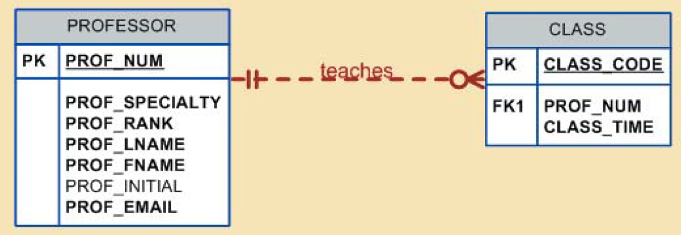
Example of a database in Tiny College
6. Each professor may teach up to four classes; each class is a section of a course. A professor may also be on a research contract and teach no classes at all.

Slide 8
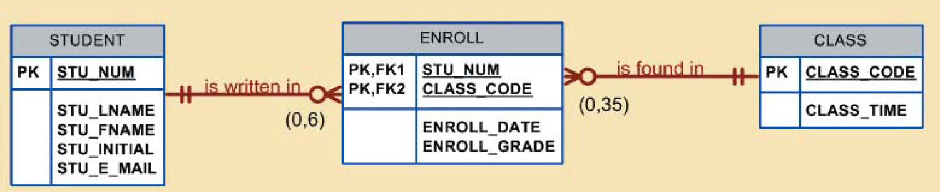
Example of a database in Tiny College
7. A student may enroll in several classes but takes each class only once during any given enrollment period. For example, during the current enrollment period, a student may decide to take five classes—Statistics, Accounting, English, Database, and History—but that student would not be enrolled in the same Statistics class five times during the enrollment period! Each student may enroll in up to six classes, and each class may have
up to 35 students, thus creating an M:N relationship between STUDENT and CLASS.

Slide 9
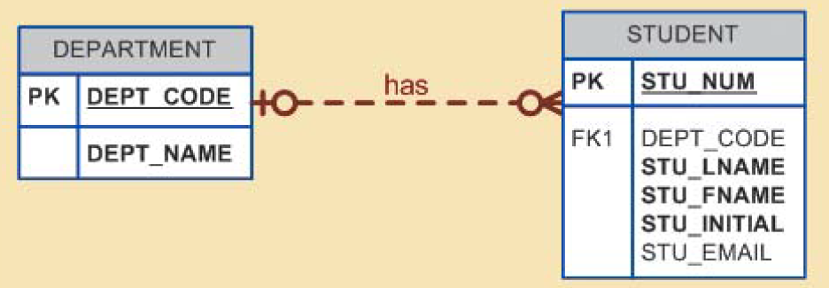
Example of a database in Tiny College
8. Each department has several (or many) students whose major is offered by that department. However, each student has only a single major and is, therefore, associated with a single department.
However, in the Tiny College environment, it is possible for a student not to declare a major field of study. Such a student would not be associated with a department; therefore, DEPARTMENT is optional to STUDENT.

Slide 10
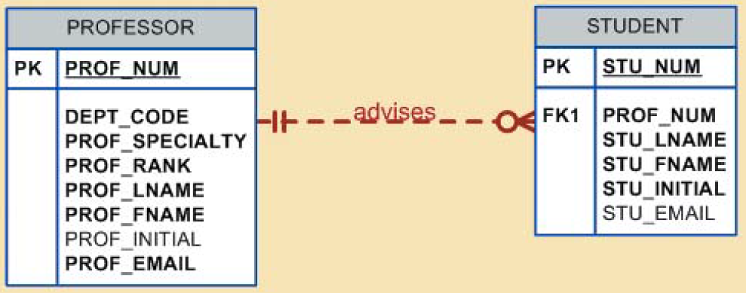
Example of a database in Tiny College
9. Each student has an advisor in his or her department; each advisor counsels several students. An advisor is also a professor, but not all professors advise students. Therefore, STUDENT is optional to PROFESSOR in the “PROFESSOR advises STUDENT” relationship.

Slide 11
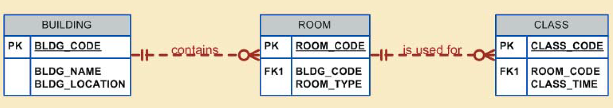
Example of a database in Tiny College
10. The CLASS entity contains a ROOM_CODE attribute. Given the naming conventions, it is clear that ROOM_CODE is an FK to another entity. Clearly, because a class is taught in a room, it is reasonable to assume that the ROOM_CODE in CLASS is the FK to an entity named ROOM. In turn, each room is located in a building. So the last Tiny College ERD is created by observing that a BUILDING can contain many ROOMs, but each ROOM is found in a single BUILDING. In this ERD segment, it is clear that some buildings do not contain (class) rooms. For example, a storage building might not contain any named rooms at all.

Slide 12
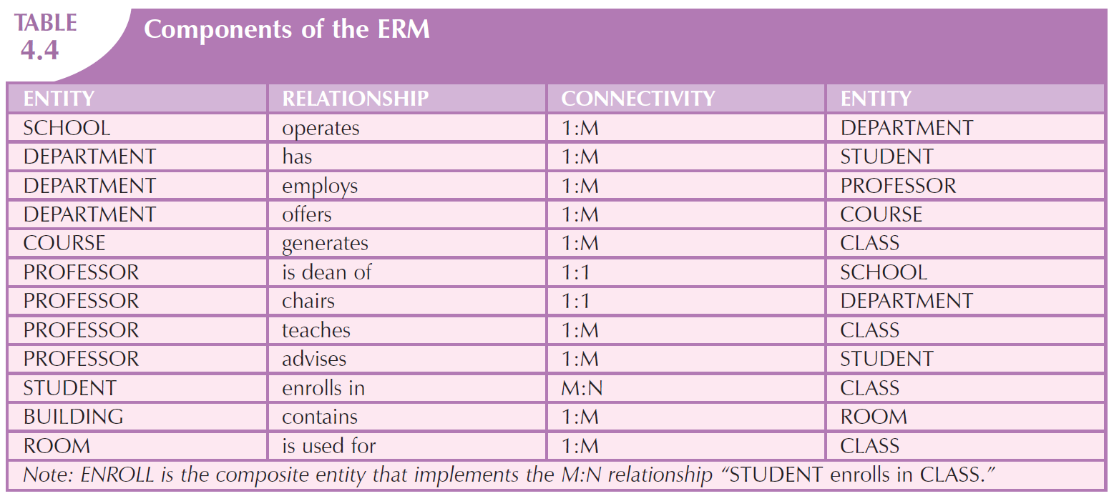

Slide 13
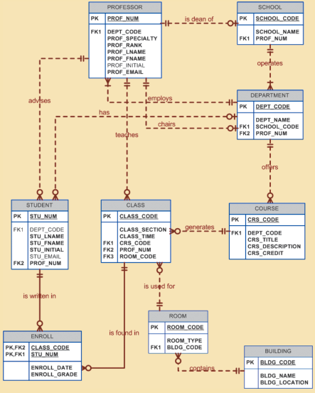
Full ERD
Textbook Page 129
Figure 4.35

